Slide 1

Go, change the world
RV College of
Engineering
Unit -4
Strings

Slide 2

RV College of
Engineering
Go, change the world
Contents
Strings Introduction, Operations on strings- finding length of a string, converting characters of a string into uppercase and lowercase, Concatenating two strings, appending a string to another string, comparing two string, reversing a string. String and character Built in functions.
Functions Introduction, Using functions, Function declaration/function prototype, Function definition, Function call, Return statement

Slide 3
Strings
Go, change the world
RV College of
Engineering
A string is nothing but the collection of the individual array elements or characters.
String is enclosed within Double quotes.
“programming" is a example of String.
Each Character Occupy 1 byte of Memory.
Size of “programming“ = 11 bytes
String is always Terminated with NULL Character (‘\0′).
char word[20] = “‘p’ , ‘r’ , ‘o’ , ‘g’ , ‘r’ , ‘a’ , ‘m’ , ‘m’ , ‘I’ , ‘n’ , ‘g’ , ‘\0’”

Slide 4
RV College of
Engineering
NULL Character
Go, change the world
NULL Character is also known as string terminating character.
It is represented by “\0”.
NULL Character is having ASCII value 0
NULL terminates a string, but isn’t part of it
important for strlen() – length doesn’t include the NULL

Slide 5
RV College of
Engineering
Declaration of a string
Go, change the world
Since we cannot declare string using String Data Type, instead of which we use array of type “char” to create String.
Syntax :
char String_Variable_name [ SIZE ] ;
Examples :
char city[30];
char name[20];
char message[50];

Slide 6
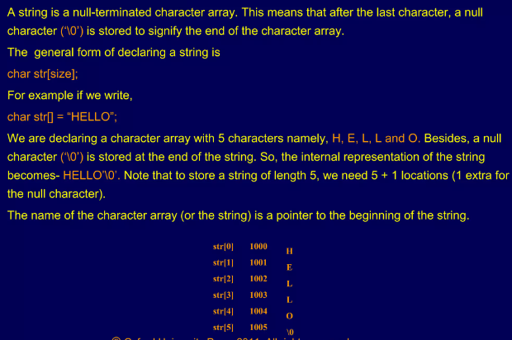
RV College of
Engineering
Declaration of a string cont…
Go, change the world

Slide 7
RV College of
Engineering
Rules for declaring a string
Go, change the world
String / Character Array Variable name should be legal C Identifier.
String Variable must have Size specified.
char city[];
Above Statement will cause compile time error.
Do not use String as data type because String data type is included in later languages such as C++ / Java. C does not support String data type
When you are using string for other purpose than accepting and printing data then you must include following header file in your code– #include<string.h>

Slide 8
RV College of
Engineering
Initializing String (Character Array)
Go, change the world
Process of Assigning some legal default data to String is Called Initialization of String.
A string can be initialized in different ways. We will explain this with the help of an example.
Below is an example to declare a string with name as str and initialize it with “HelloWorld”.
char str[] = “HelloWorld";
char str[50] = “HelloWorld";
char str[] = {‘H','e',’l',’l',’o',’W','o','r',’l',’d','\0'};
char str[11] = {‘H','e',’l',’l',’o',’W','o','r',’l',’d','\0'};

Slide 9
RV College of
Engineering
String Example
Go, change the world
#include <stdio.h>
int main () {
char greeting[6] = {'H', 'e', 'l', 'l', 'o', '\0'};
printf("Greeting message: %s\n", greeting );
return 0; }
When the above code is compiled and executed, it produces the following result −
Greeting message: Hello

Slide 10
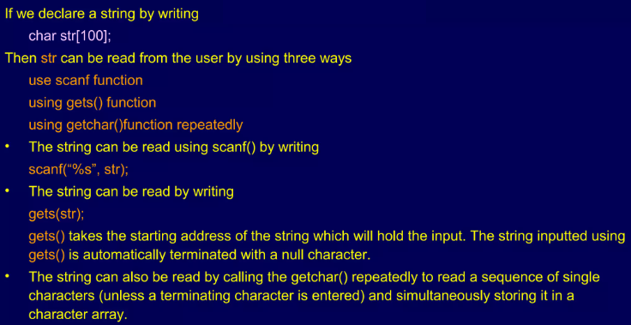
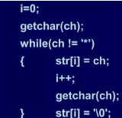
RV College of
Engineering
Reading Strings
Go, change the world

Slide 11
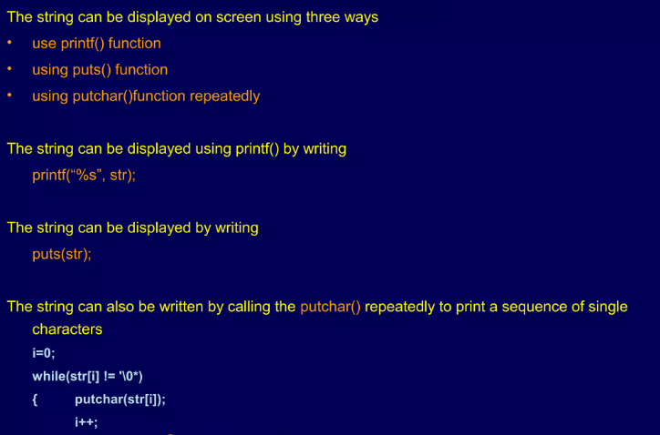
RV College of
Engineering
Writing Strings
Go, change the world

Slide 12
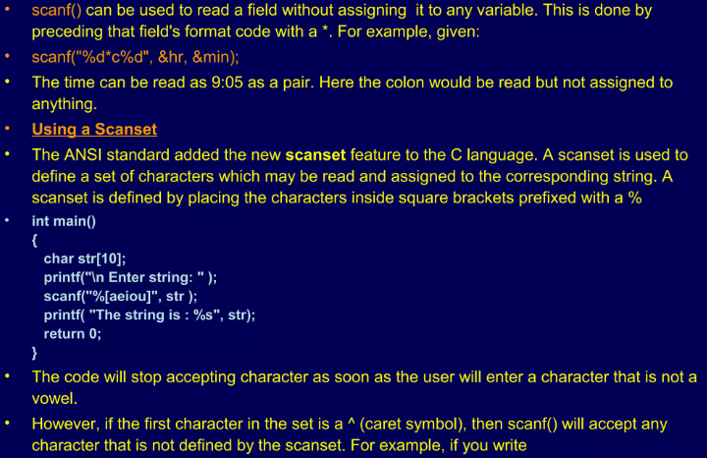
RV College of
Engineering
Suppressing Input
Go, change the world

Slide 13
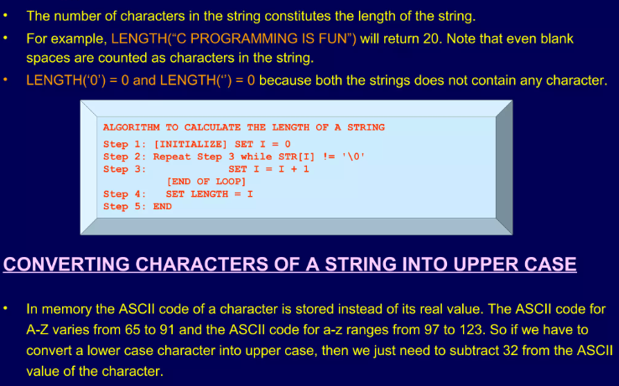
RV College of
Engineering
Length
Go, change the world

Slide 14
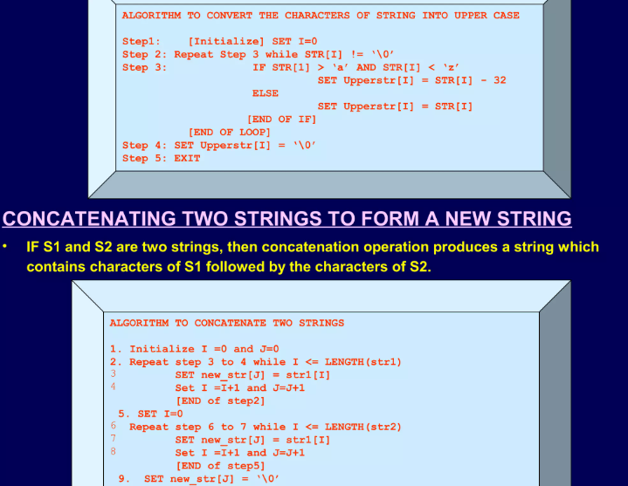
Converting Character of Strings to Upper Case
RV College of
Engineering
Go, change the world

Slide 15
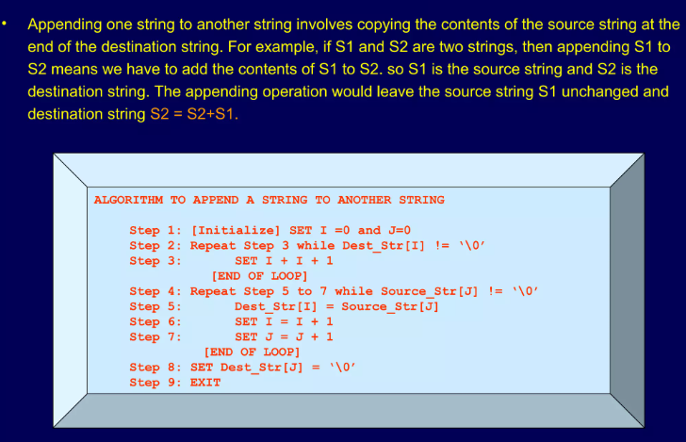
RV College of
Engineering
Appending
Go, change the world

Slide 16
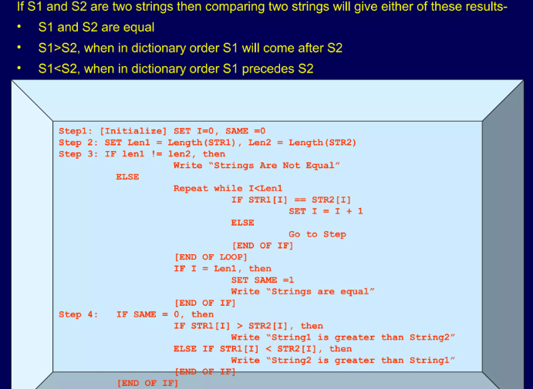
RV College of
Engineering
Comparing Two Strings
Go, change the world

Slide 17
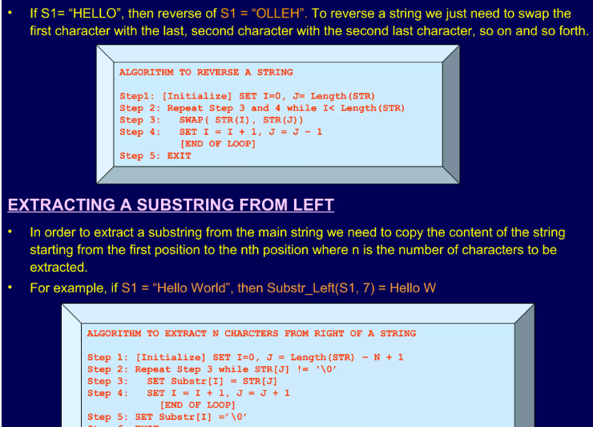
RV College of
Engineering
Reversing a String
Go, change the world

Slide 18
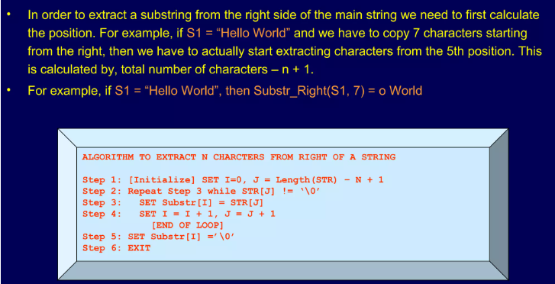
RV College of
Engineering
Extracting a substring from Right of the String
Go, change the world

Slide 19
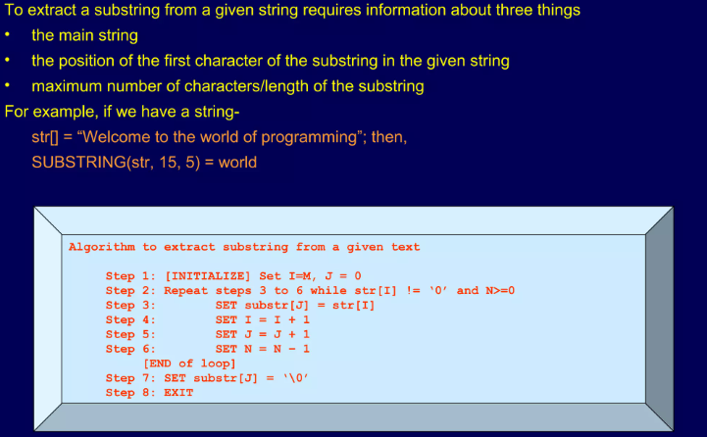
RV College of
Engineering
Extracting a substring from Middle of the String
Go, change the world

Slide 20
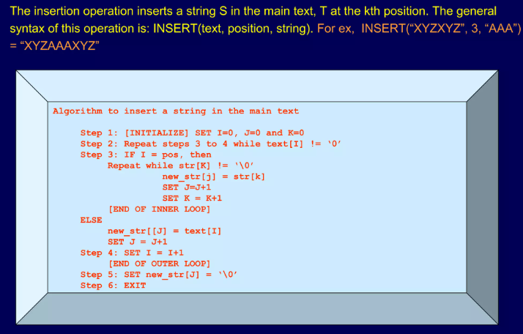
RV College of
Engineering
Insertion
Go, change the world

Slide 21
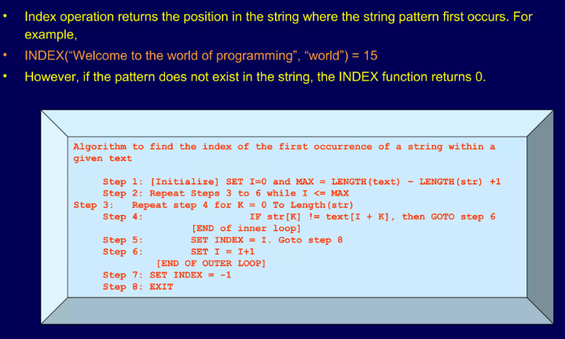
RV College of
Engineering
Indexing
Go, change the world

Slide 22
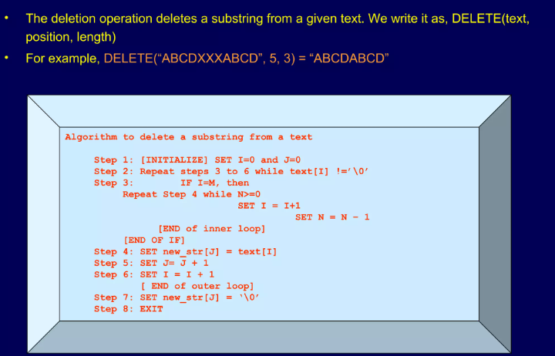
RV College of
Engineering
Deletion
Go, change the world

Slide 23
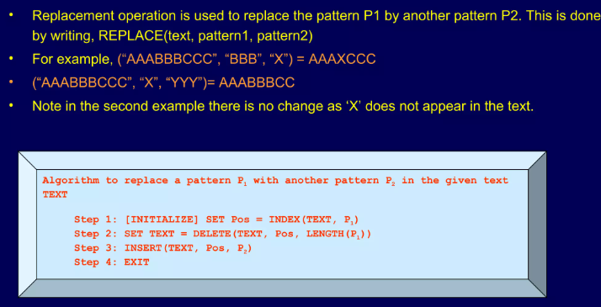
RV College of
Engineering
Replacement
Go, change the world

Slide 24
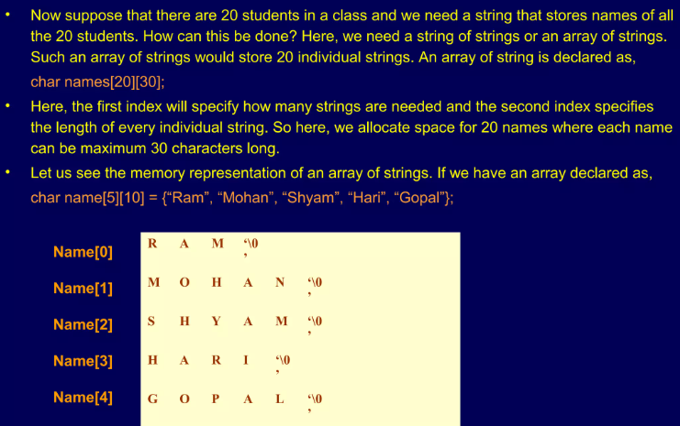
RV College of
Engineering
Array of Strings
Go, change the world

Slide 25
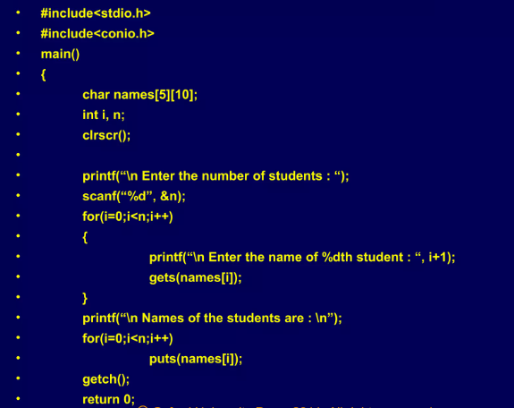
RV College of
Engineering
Go, change the world
Write a program to read and print the names of n students in the class

Slide 26
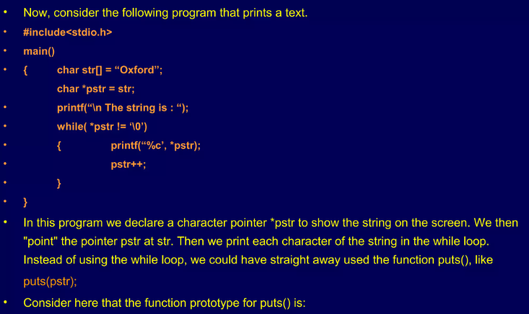
RV College of
Engineering
Pointers and Strings
Go, change the world
int puts(const char *s); Here the constant modifier is used to assure the user that the function will not modify the contents pointed to by the source pointer. Note that the address of the pointer is passed to the function as the argument.

Slide 27
Functions of string.h
Go, change the world
RV College of
Engineering
Function | Purpose | Example | Output
Strcpy(); | Makes a copy of a string | strcpy(s1, “Hi”); | Copies “Hi” to ‘s1’ variable
Strcat(); | Appends a string to the end of another string | strcat(“Work”, “Hard”); | Prints “WorkHard”
Strcmp(); | Compare two strings alphabetically | strcmp(“hi”, “bye”); | Returns -1.
Strlen(); | Returns the number of characters in a string | strlen(“Hi”); | Returns 2.
Strrev(); | reverses a given string | Strrev(“Hello”); | olleH
Strlwr(); | Converts string to lowercase | Strlwr(“HELLO”); | hello
Strupr(); | Converts string to uppercase | Strupr(“hello”); | HELLO

Slide 28
RV College of
Engineering
String Copy (strcpy)
Go, change the world
strcpy( ) function copies contents of one string into another string.
Syntax : strcpy (destination_string , source_string );
Example:-strcpy ( str1, str2) – It copies contents of str2 into str1.
strcpy ( str2, str1) – It copies contents of str1 into str2.
If destination string length is less than source string, entire source string value won’t be copied into destination string. For example, consider destination string length is 20 and source string length is 30. Then, only 20 characters from source string will be copied into destination string and remaining 10 characters won’t be copied and will be truncated.

Slide 29
RV College of
Engineering
String Concat (strcat)
Go, change the world
strncat( ) function in C language concatenates (appends) portion of one string at the end of another string.
Syntax : strncat ( destination_string , source_string, size);
Example:-strncat ( str2, str1, 3 ); – First 3 characters of str1 is concatenated at the end of str2.
As you know, each string in C is ended up with null character (‘\0’).
In strncat( ) operation, null character of destination string is overwritten by source string’s first character and null character is added at the end of new destination string which is created after strncat( ) operation.

Slide 30
RV College of
Engineering
String Compare (strcmp)
Go, change the world
strcmp( ) function in C compares two given strings and returns zero if they are same.
If length of string1 < string2, it returns < 0 value that is -1.
If length of string1 > string2, it returns > 0 value that is 1
If length of string1 = string2 it returns 0.
Syntax : strcmp (str1 , str2 );strcmp( ) function is case sensitive. i.e, “A” and “a” are treated as different characters.

Slide 31
RV College of
Engineering
String Concat (strcat)
Go, change the world
strncat( ) function in C language concatenates (appends) portion of one string at the end of another string.
Syntax : strncat ( destination_string , source_string, size);
Example:-strncat ( str2, str1, 3 ); – First 3 characters of str1 is concatenated at the end of str2.
As you know, each string in C is ended up with null character (‘\0’).
In strncat( ) operation, null character of destination string is overwritten by source string’s first character and null character is added at the end of new destination string which is created after strncat( ) operation.

Slide 32
RV College of
Engineering
String Length (strlen)
Go, change the world
strlen( ) function in C gives the length of the given
string.
Syntax : strlen(str);
strlen( ) function counts the number of characters in a given
string and returns the integer value.
It stops counting the character when null character is found. Because, null character indicates the end of the string in C.

Slide 33
RV College of
Engineering
Go, change the world
END of Strings in UNIT-4

Slide 34
Go, change the world
RV College of
Engineering
INTRODUCTION TO C PROGRAMMING (22ES14A)
UNIT IV
Functions (User Defined Functions)

Slide 35
FUNCTIONS
A function in C language is a block of code that performs a specific task.
It has a name and it is reusable i.e. it can be executed from as many different parts in a C Program as required.
It also optionally returns a value to the calling program.
RV College of
Engineering
Go, change the world

Slide 36
Properties of C Functions:
Every function has a unique name. This name is used to call function from “main()” function. A function can be called from within another function.
A function is independent and it can perform its task without intervention from or interfering with other parts of the program.
A function performs a specific task. A task is a distinct job that your program must perform as a part of its overall operation, such as adding two or more integer, sorting an array into numerical order, or calculating a cube root etc.
RV College of
Engineering
Go, change the world

Slide 37
Properties of C Functions:
A function returns a value to the calling program.
This is optional and depends upon the task your function is going to accomplish.
Suppose you want to just show few lines through function then it is not necessary to return a value.
But if you are calculating area of rectangle and wanted to use result somewhere in program then you have to send back (return) value to the calling function.
RV College of
Engineering
Go, change the world

Slide 38
Types of functions in C
void function(void)
void function(int)
int function(void)
int function(int)
RV College of
Engineering
Go, change the world

Slide 39

RV College of
Engineering
Go, change the world
Type-1
void function(void)

Slide 40
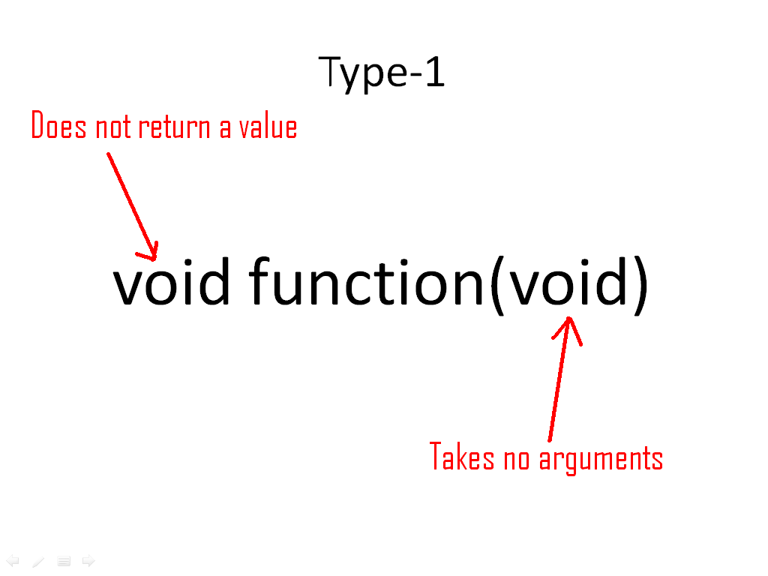
Type-1: void function(void)
RV College of
Engineering
Go, change the world

Slide 41
Type-1: void function(void)
RV College of
Engineering
Go, change the world
#include<conio.h>
#include<stdio.h>
void rvce(void); //function declaration
void main()
{
clrscr();
rvce(); //function call
getch();
}
void rvce(void) //function definition
{
printf(”rvce");
}

Slide 42
RV College of
Engineering
Go, change the world
Output:
Rvce
We can call a function for more than once in main.

Slide 43
RV College of
Engineering
Go, change the world
#include<conio.h>
#include<stdio.h>
void rvce(void);
void main()
{
clrscr();
rvce();
rvce();
getch();
}
void rvce(void)
{
printf(”rvce");
}

Slide 44
Type-1: void function(void)
RV College of
Engineering
Go, change the world
#include<conio.h>
#include<stdio.h>
void rvce(void); //function declaration
void main()
{
clrscr();
rvce(); //function call
getch();
}
void rvce(void) //function definition
{
printf(”rvce");
}

Slide 45
Output:
rvce rvce
We can build/call more than one functions in our program.
RV College of
Engineering
Go, change the world

Slide 46
RV College of
Engineering
Go, change the world
#include<stdio.h>
void rvce(void);
void college(void);
void main()
{
clrscr();
rvce();
college();
}
void rvce(void)
{
printf(”rvce");
}
void college (void)
{
printf(“college is rvce");
}

Slide 47
RV College of
Engineering
Go, change the world
Output
rvce
college is rvce

Slide 48
RV College of
Engineering
Go, change the world
Type-2
void function(int)

Slide 49
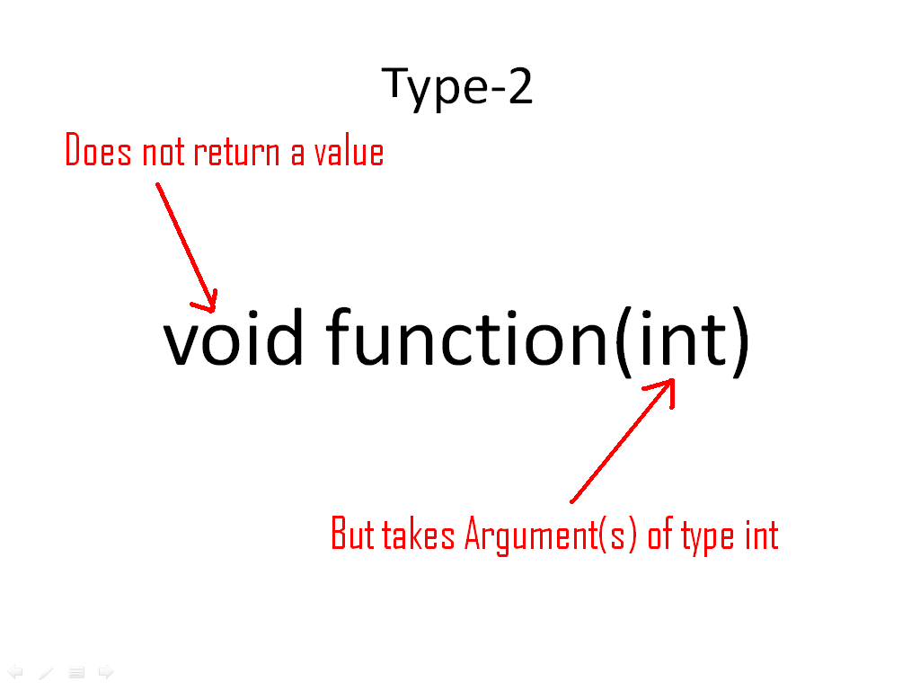
RV College of
Engineering
Go, change the world

Slide 50
#include<conio.h>
#include<stdio.h>
void square(int);
void main()
{
clrscr();
square(5);
getch();
}
void square(int x)
{
printf("Square is %d",x*x);
}
RV College of
Engineering
Go, change the world

Slide 51
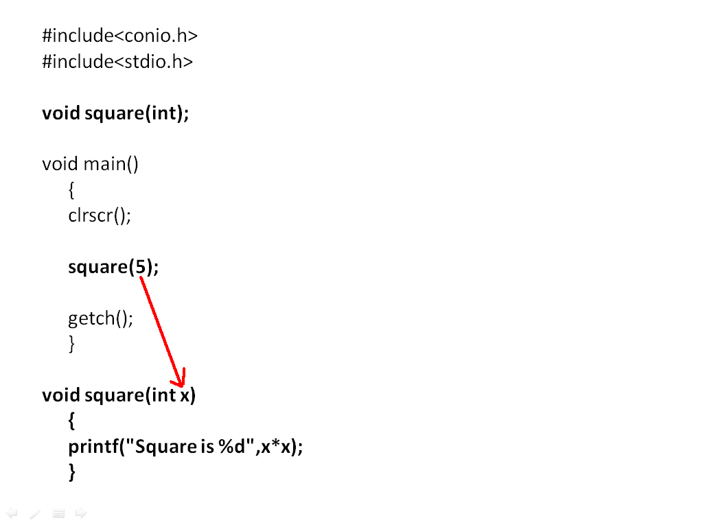
RV College of
Engineering
Go, change the world

Slide 52
Output
Square is 25

Slide 53
RV College of
Engineering
Go, change the world
#include<conio.h>
#include<stdio.h>
void table(int);
void main()
{
clrscr();
table(5);
getch();
}
void table(int x)
{
for(int a=1;a<=10;a++)
printf("%d*%d=%d\n",a,x,a*x);
}

Slide 54
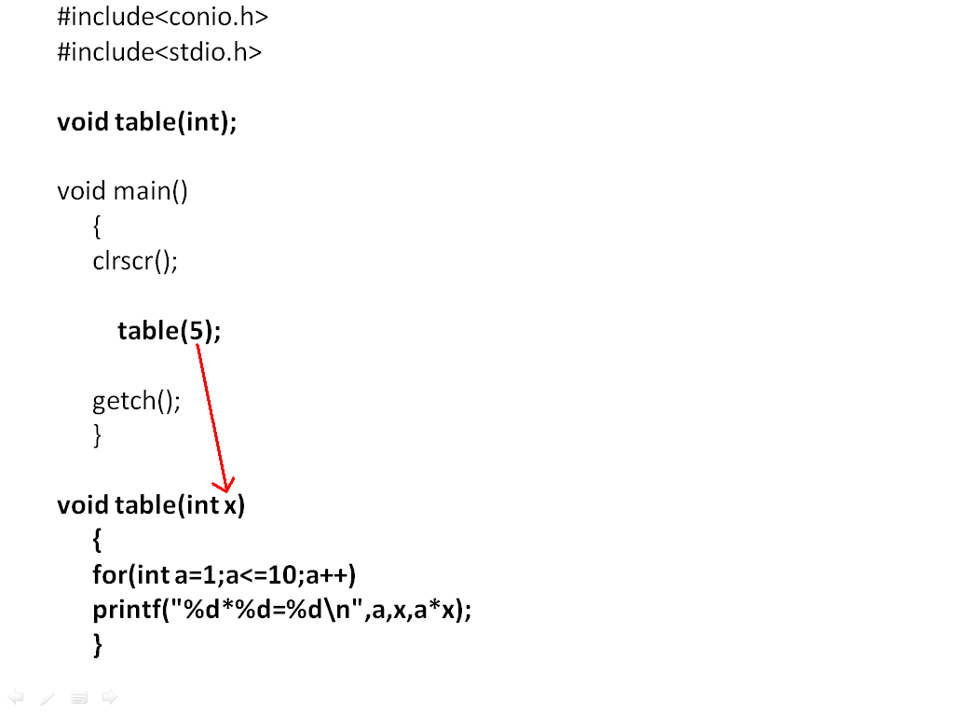
RV College of
Engineering
Go, change the world

Slide 55
RV College of
Engineering
Go, change the world
Output
1*5=5
2*5=10
3*5=15
4*5=20
5*5=25
6*5=30
7*5=35
8*5=40
9*5=45
10*5=50
We can pass more than one arguments to a function, each can have different type/same type.

Slide 56
RV College of
Engineering
Go, change the world
#include<conio.h>
#include<stdio.h>
void add(int, int);
void main()
{
clrscr();
add(5, 7);
getch();
}
void add(int x, int y)
{
printf(“Addition is %d",x+y);
}

Slide 57
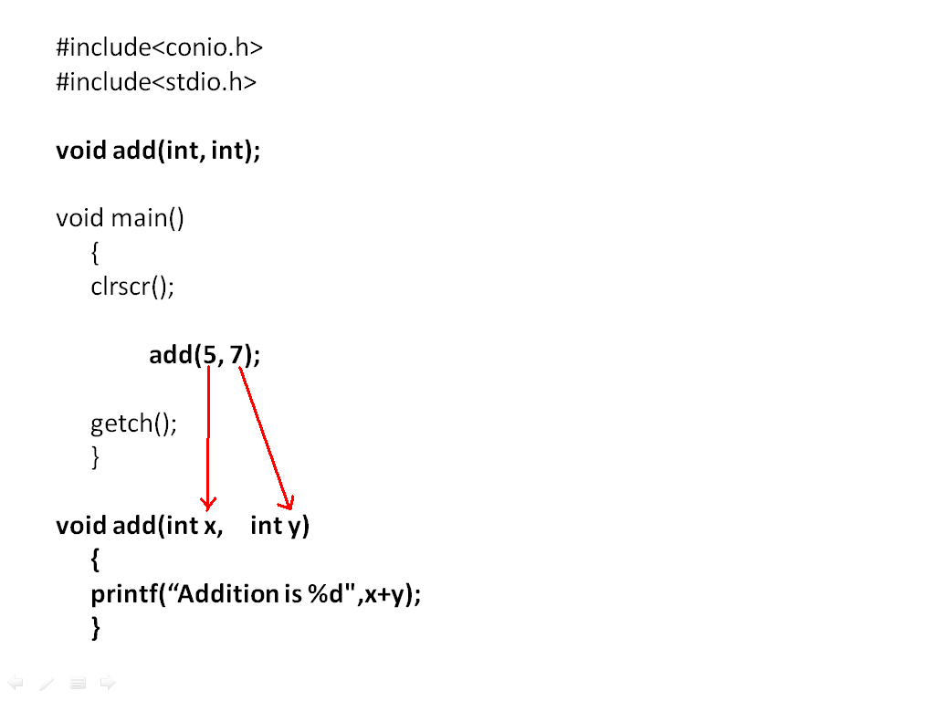
RV College of
Engineering
Go, change the world
Output
Addition is 12

Slide 58
RV College of
Engineering
Go, change the world
Write a program to generate a loop between two numbers.(Use functions to achieve the task)
#include<conio.h>
#include<stdio.h>
Void makeloop(int, int);
void main()
{
clrscr();
makeloop (2, 15);
getch();
}
void makeloop (int x, int y)
{
for(int a=x; a<=y; a++)
printf(“%d,”, a);
}

Slide 59
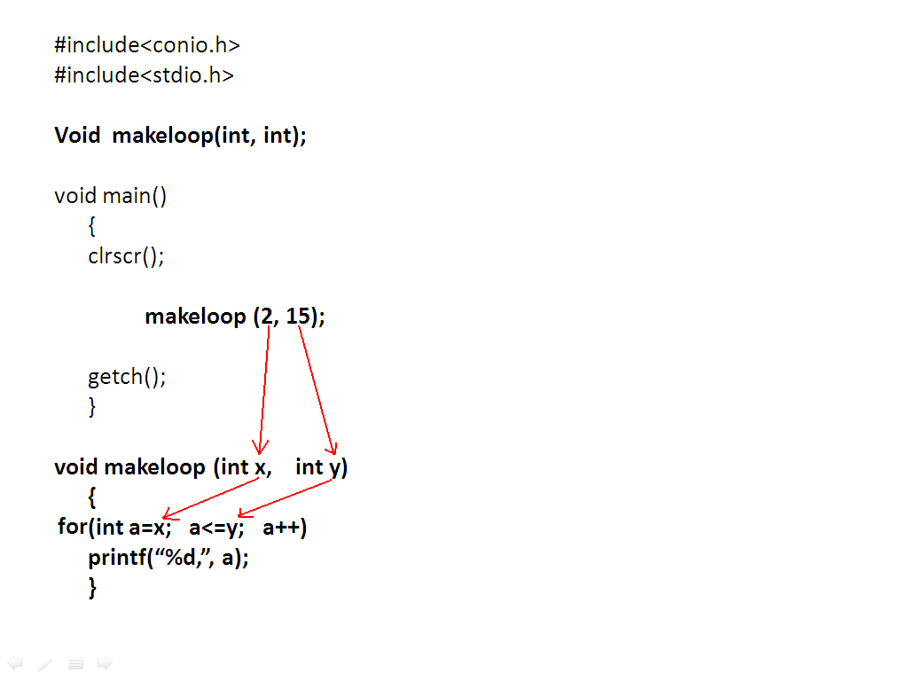
RV College of
Engineering
Go, change the world
Output
2,3,4,5,6,7,8,9,10,11,12,13,14,15

Slide 60
RV College of
Engineering
Go, change the world
Edit same program, get two numbers input from user, then make a loop between these numbers.
Ex:
Please input two numbers: 5 20
5,6,7,8,9,10,11,12,13,14,15,16,17,18,19,20

Slide 61
RV College of
Engineering
Go, change the world
#include<conio.h>
#include<stdio.h>
Void makeloop(int, int);
void main()
{
clrscr();
int start, end
printf(“Plzz input two numbers:”);
scanf(“%d%d”, start, end);
makeloop (start, end);
getch();
}
void makeloop (int x, int y)
{
for(int a=x; a<=y; a++)
printf(“%d,”, a);
}

Slide 62
RV College of
Engineering
Go, change the world
Type-3
int function(void)

Slide 63
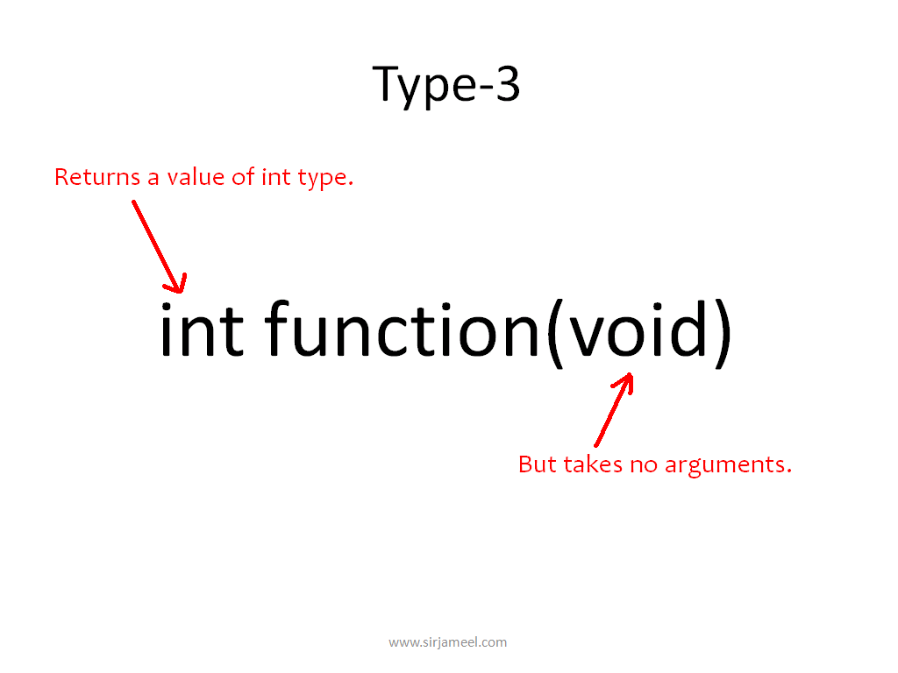
RV College of
Engineering
Go, change the world

Slide 64
RV College of
Engineering
Go, change the world
#include<conio.h>
#include<stdio.h>
int sum(void);
void main()
{
clrscr();
int a;
a=sum();
printf(“Sum is %d”, a);
getch();
}
int sum(void)
{
int x=2, y=3, z;
z=x+y;
return(z);
}

Slide 65
RV College of
Engineering
Go, change the world
#include<conio.h>
#include<stdio.h>
int sum(void);
void main()
{
clrscr();
int a;
a=sum();
printf(“Sum is %d”, a);
getch();
}
int sum(void)
{
int x=2, y=3, z;
z=x+y;
return(z);
}

Slide 66
RV College of
Engineering
Go, change the world
Return Keyword
In functions, where we return any value, we usually use a keyword “return”, and the value, which is to be returned is written inside braces, shown after return.
Example: return(z);
The above statement will pass the value of z to the left side variable of calling function.
ie: a=sum();
Hence the value in z, which is 5 in our program is passed to a.

Slide 67
RV College of
Engineering
Go, change the world
Type-4
Returns a value.
int function(int)
Passes the argument(s).

Slide 68
RV College of
Engineering
Go, change the world
#include<conio.h>
#include<stdio.h>
int sum(int, int);
void main()
{
clrscr();
int a;
a=sum(2,3);
printf(“Sum is %d”, a);
getch();
}
int sum(int x, int y)
{
z=x+y;
return(z);
}

Slide 69
RV College of
Engineering
Go, change the world
#include<conio.h>
#include<stdio.h>
int sum(int, int);
void main()
{
clrscr();
int a;
a=sum(2,3);
printf(“Sum is %d”, a);
getch();
}
int sum(int x, int y)
{
z=x+y;
return(z);
}

Slide 70
RV College of
Engineering
Go, change the world
End of the Functions in Unit - 4

